Slide 1

Mode 14 pT Training Result using k-NN
Wei Shi, Jamal Rorie
weishi@rice.edu
EMTF Working Meeting

Slide 2
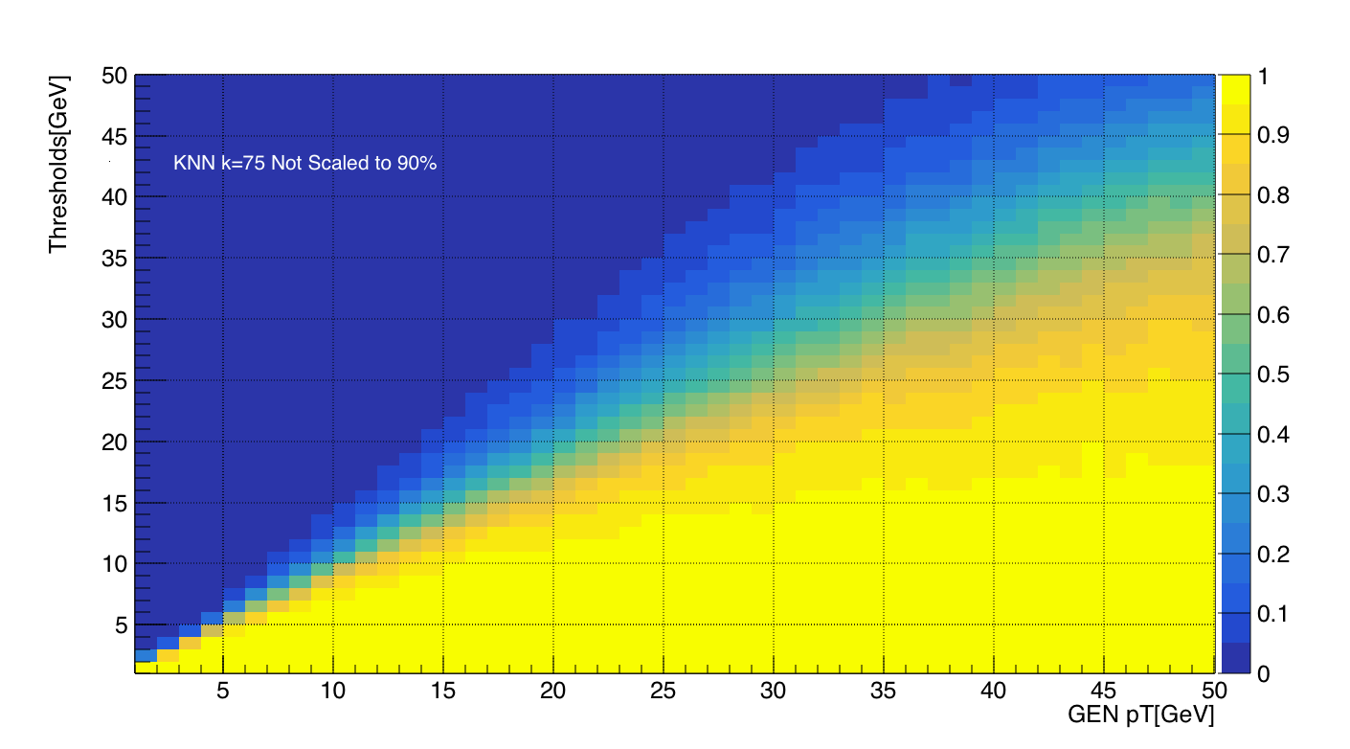
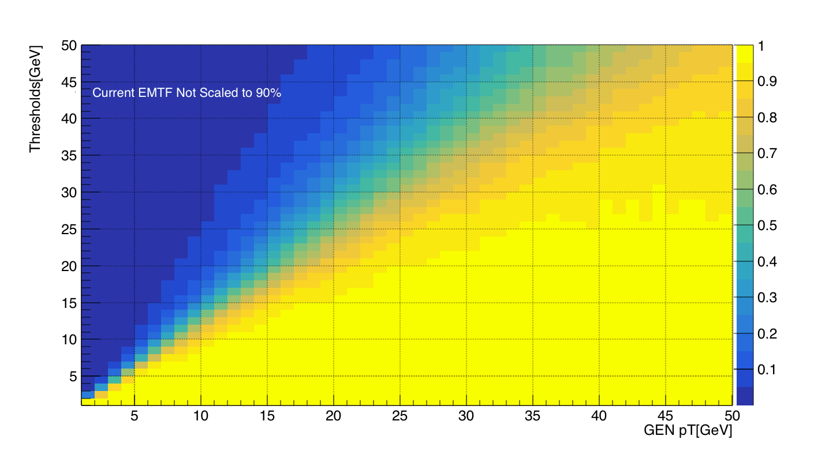
Trigger efficiency(k=75)
KNN (Not scaled)
EMTF(Current was scaled to ~80%)

Slide 3
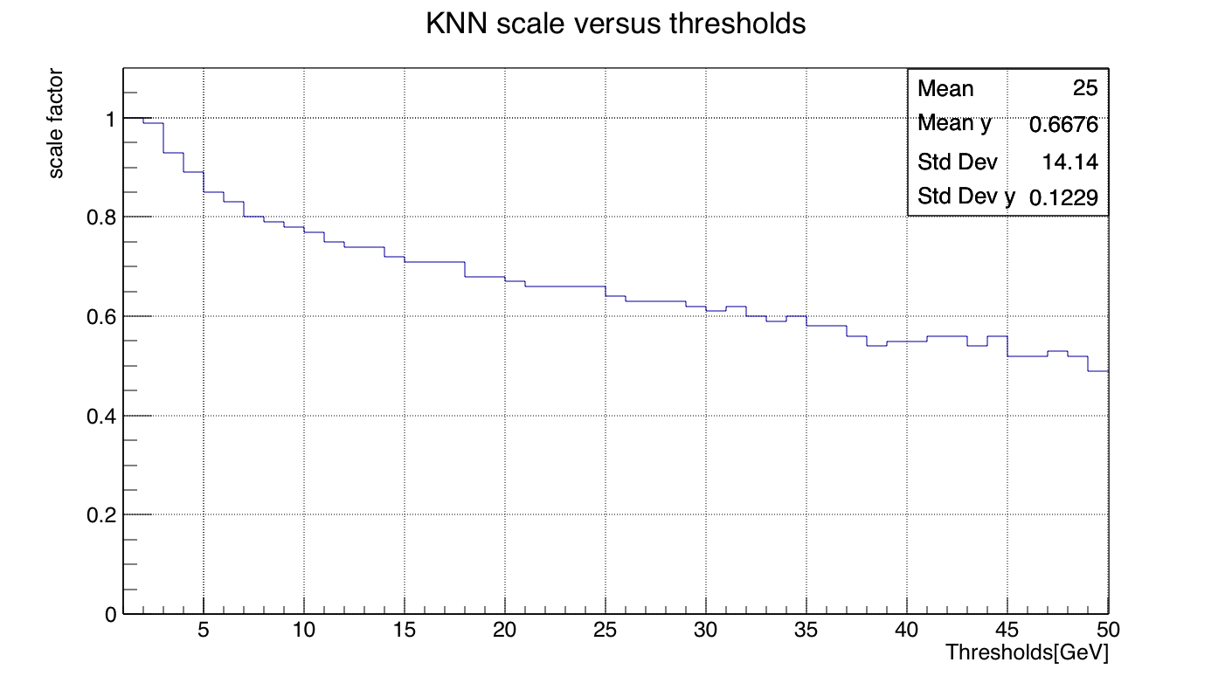
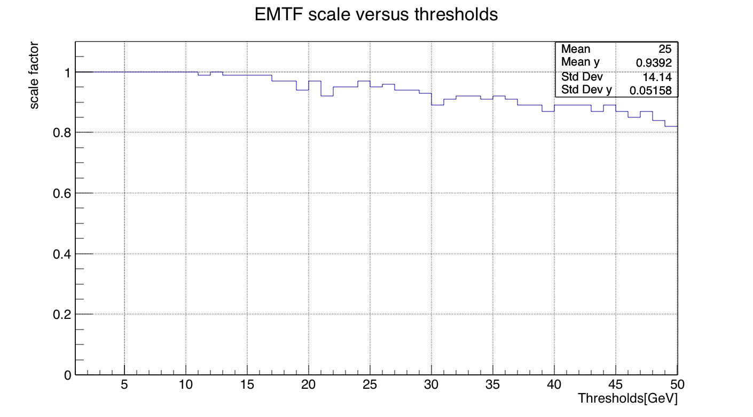
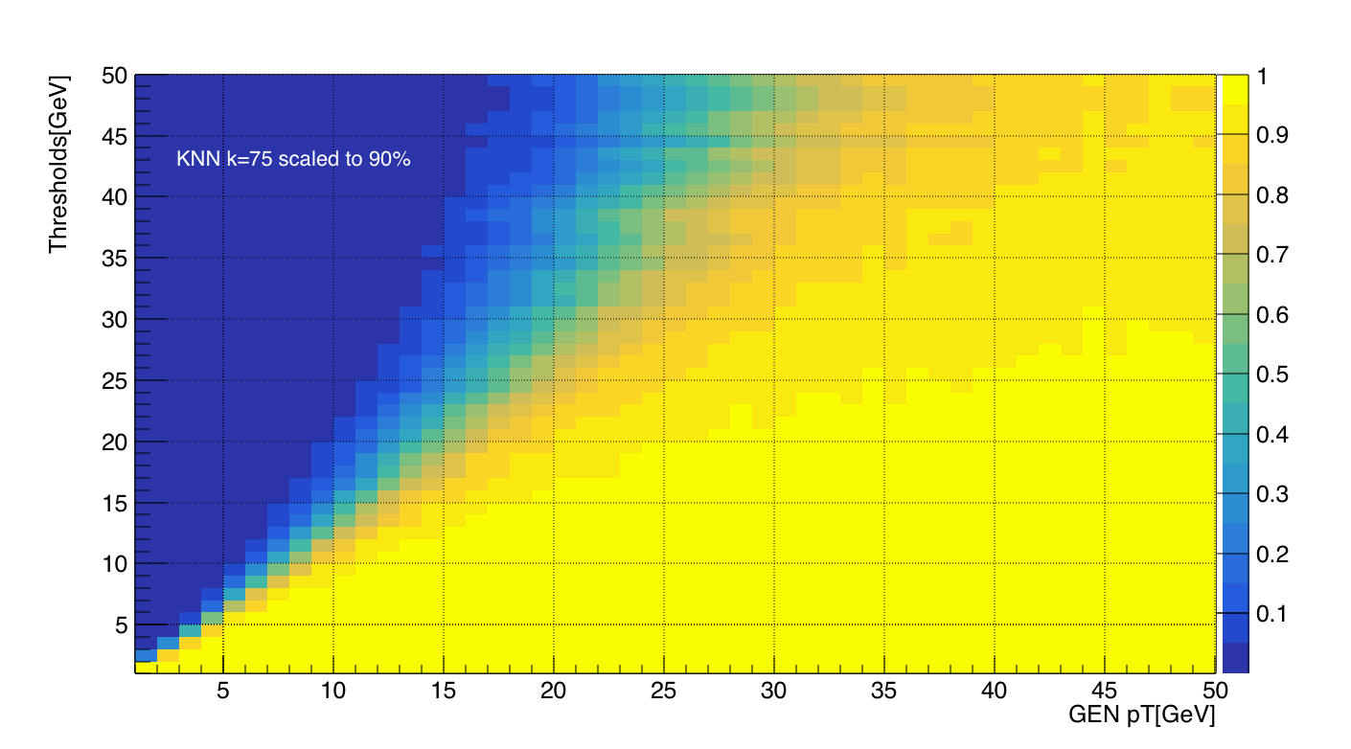
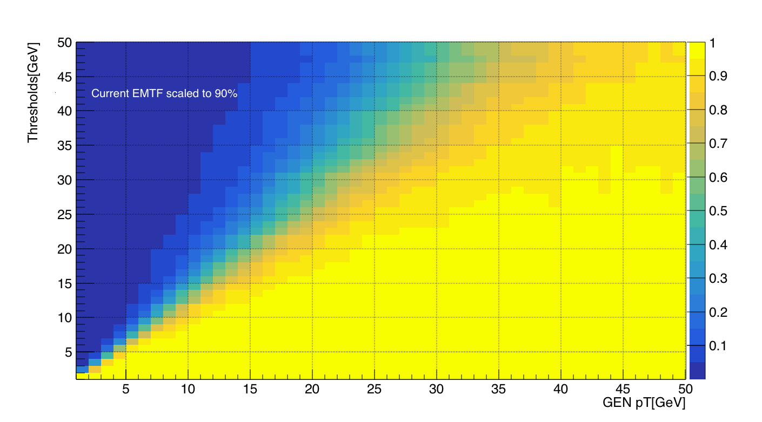
Scale KNN efficiency to 90% at each threshold by multiplying a factor
Trigger efficiency(k=75)
KNN (Scaled)
EMTF(Scaled)

Slide 4
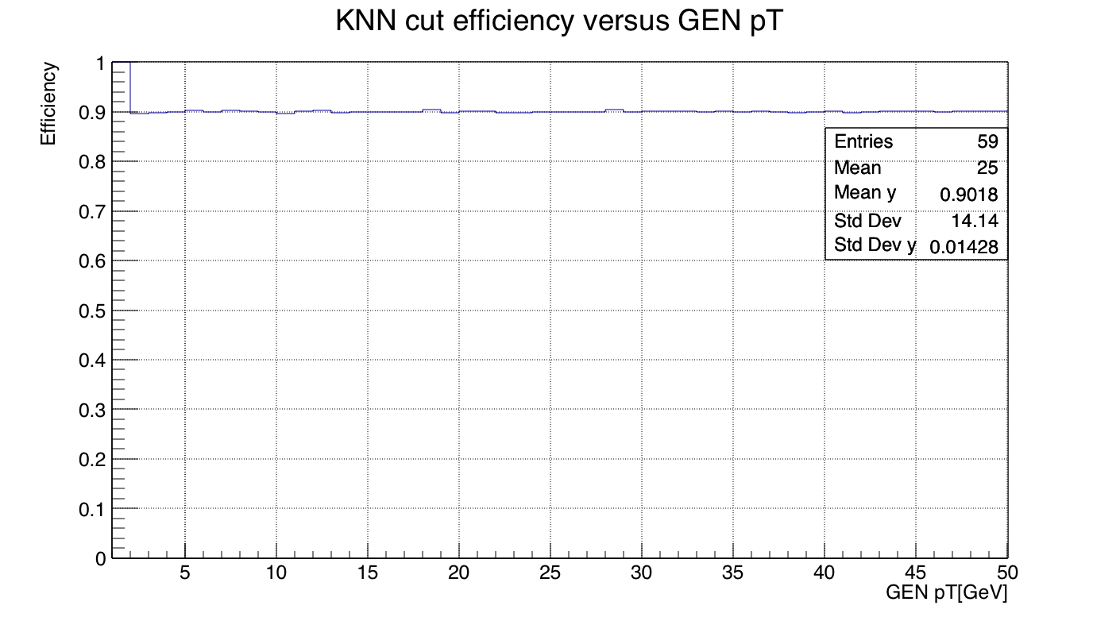
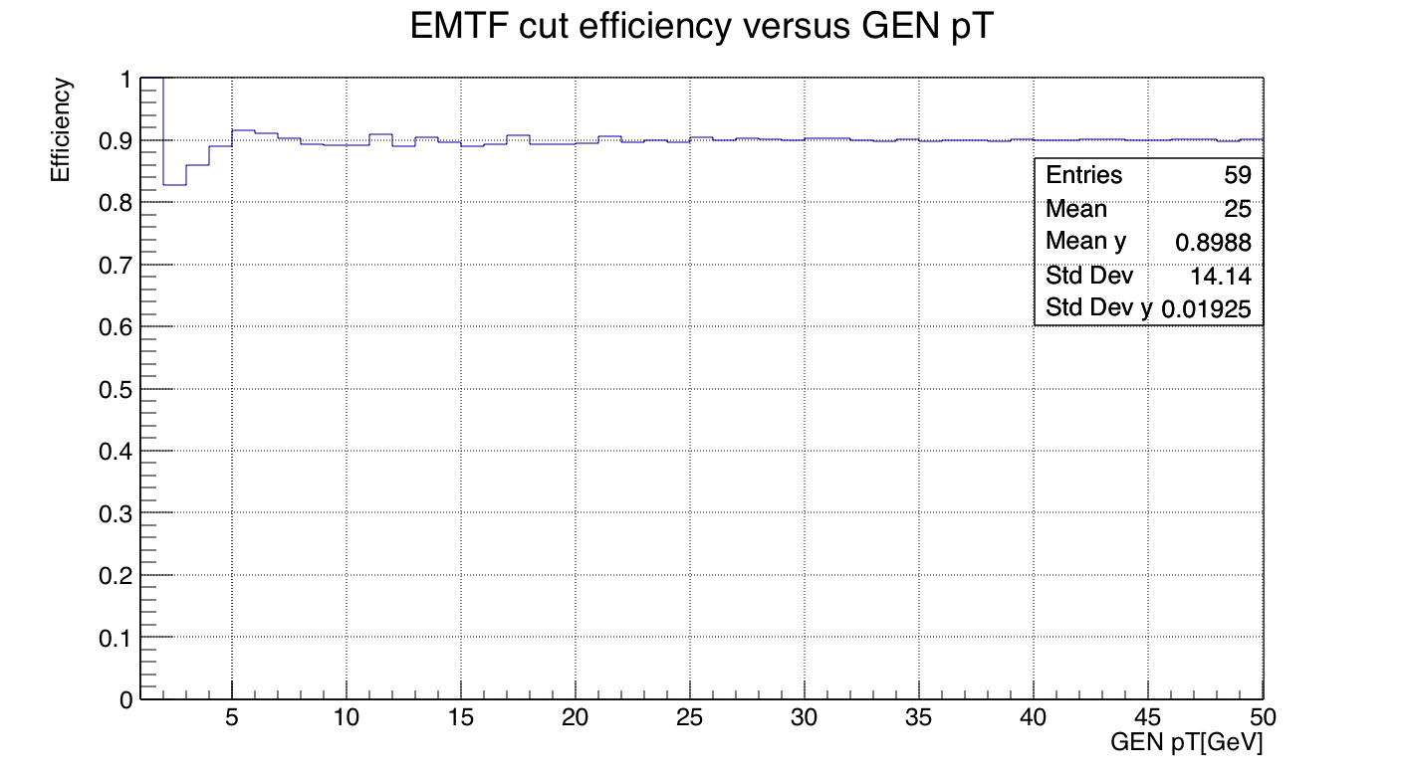
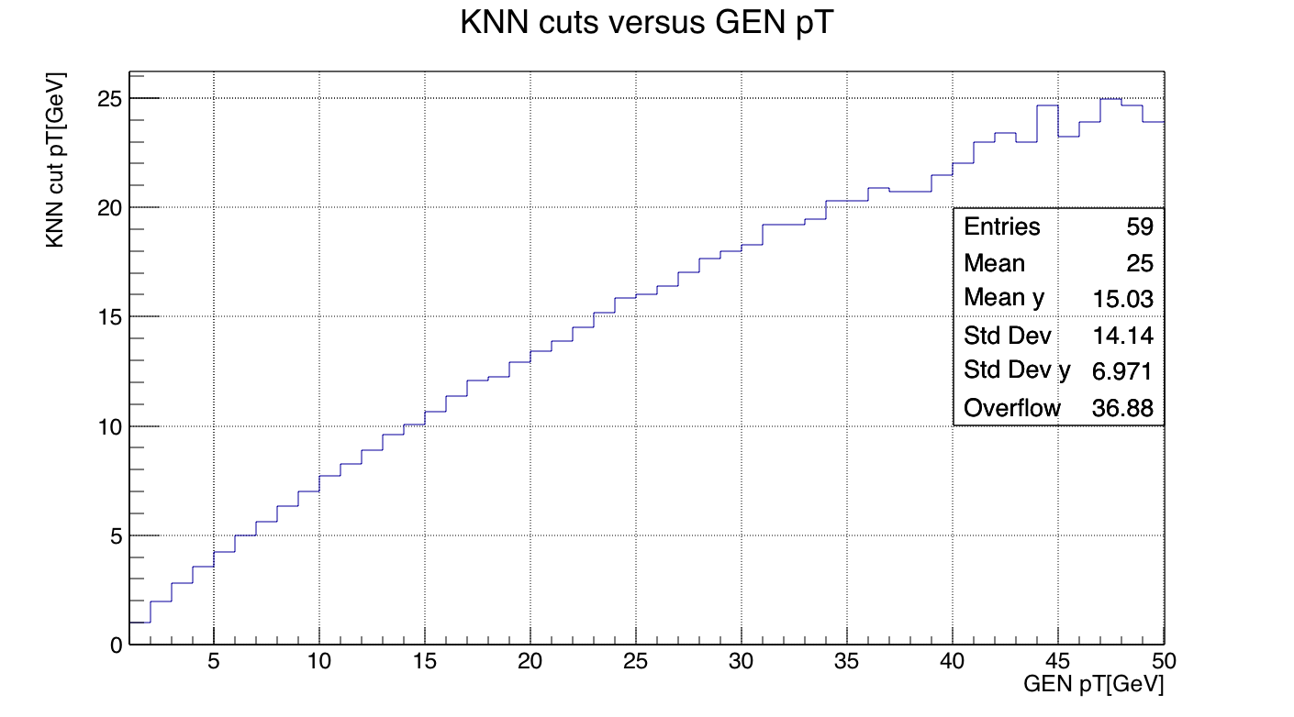
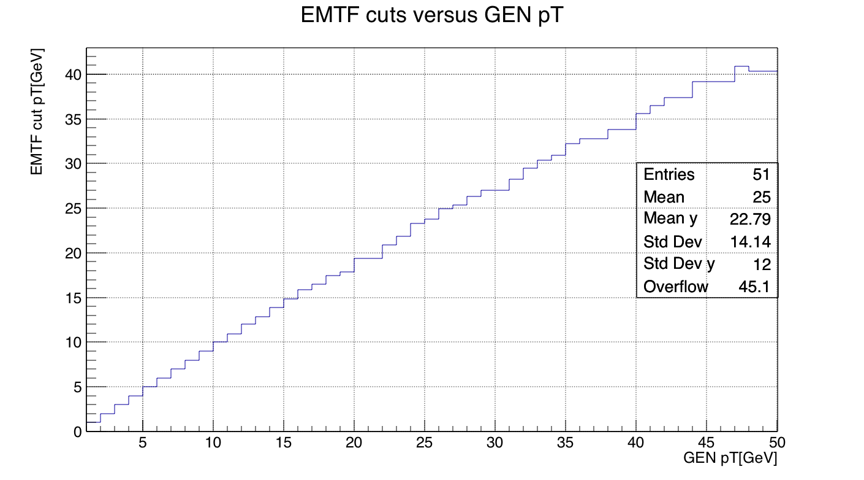
Find 90% efficiency cut pT

Slide 5
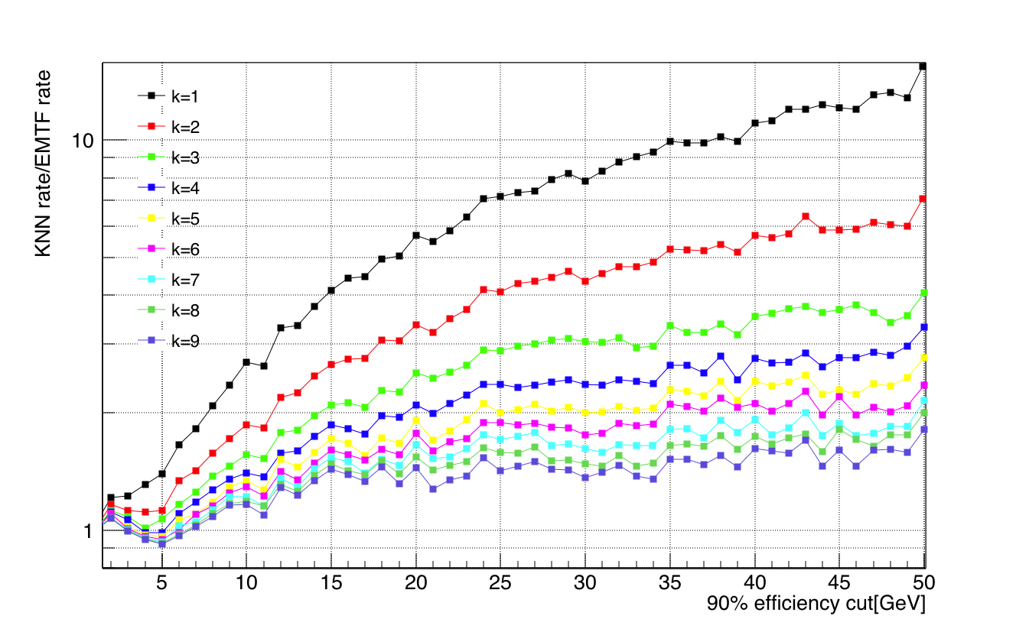
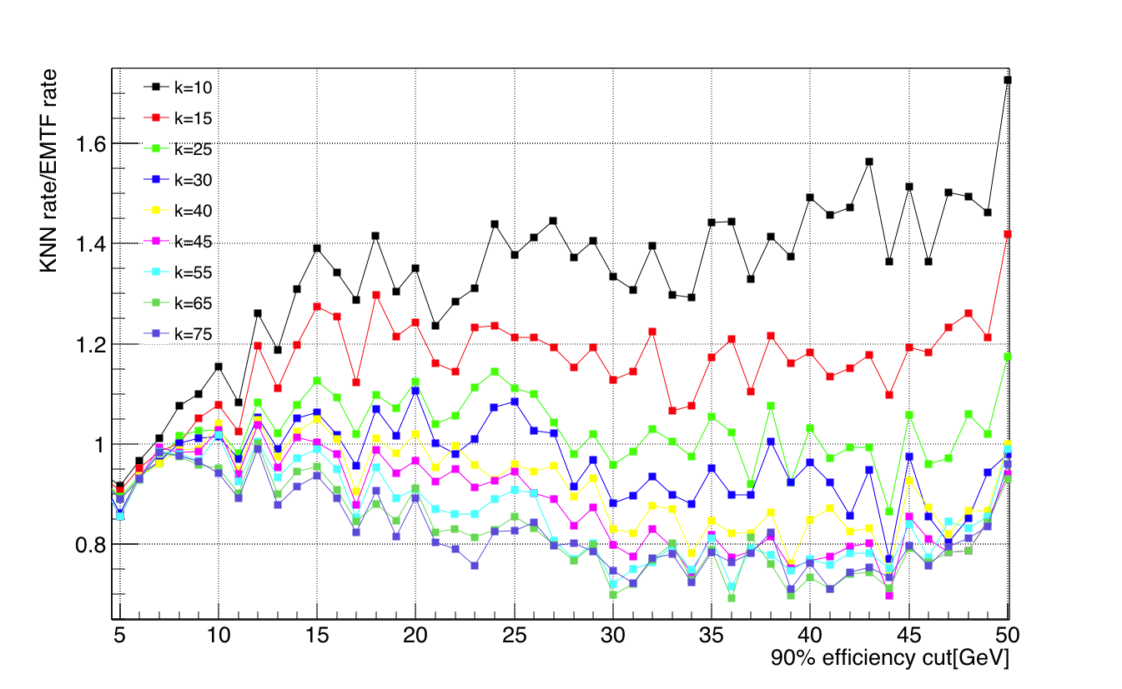
Plot ratio: k-NN rate/EMTF rate
90% efficiency cut
For k in [1, 75], performance goes better as k increases
Approximate the current EMTF at k~25
Good rate reduction performance in pT 5-50 GeV for k~75

Slide 6
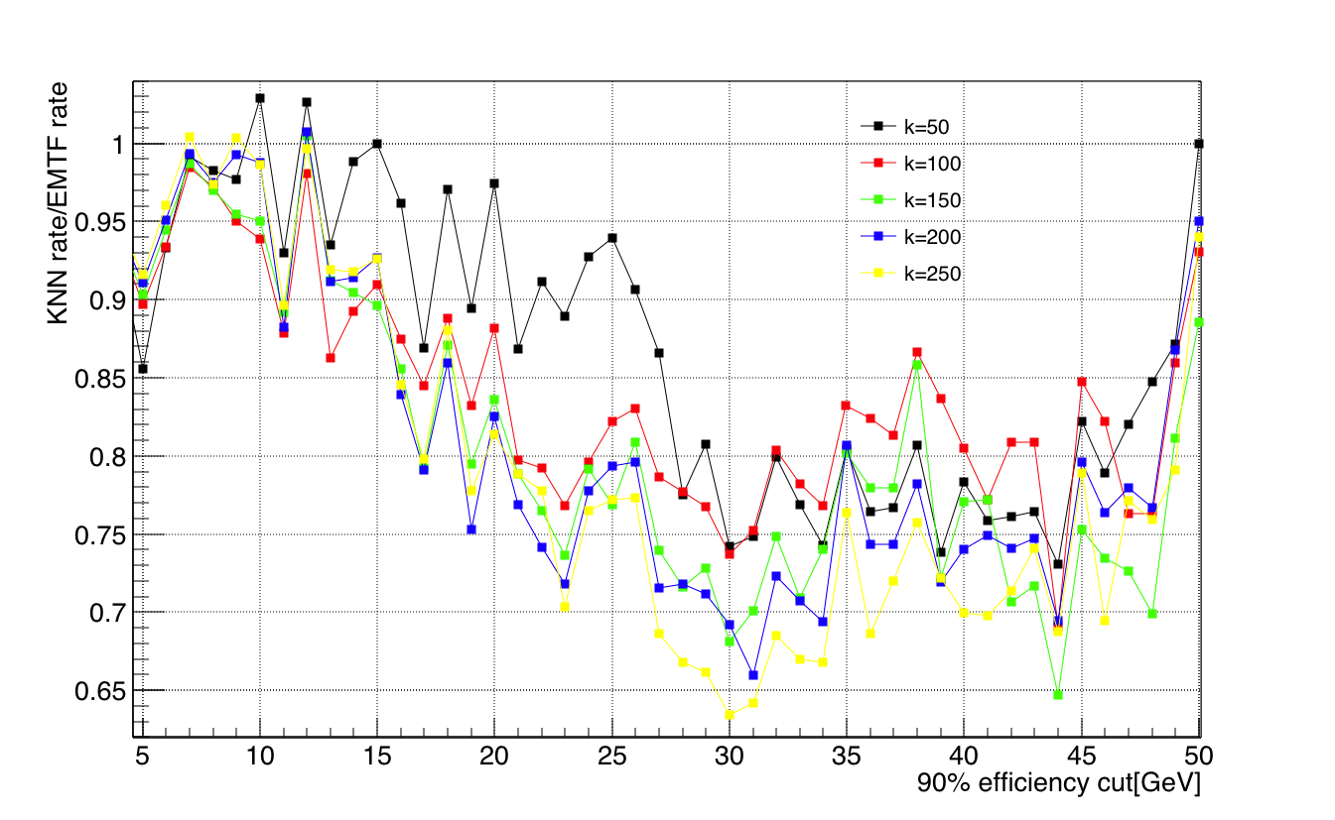
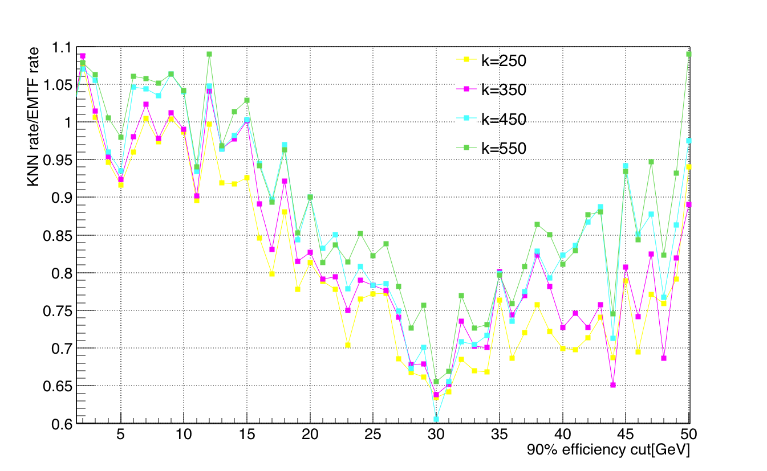
Large scan step: 50 and 100
Wide scan shows good rate reduction keeps until k~250
Start to degrade the performance as k goes from 250 to 550
A good stop at k~550, no need to go larger
Very long time for training/testing at k ~ O(10³), time complexity of k-NN is O(k*logN) in TMVA, not feasible
Very large k is bad for high pT according to previous MSE results (backup)

Slide 7
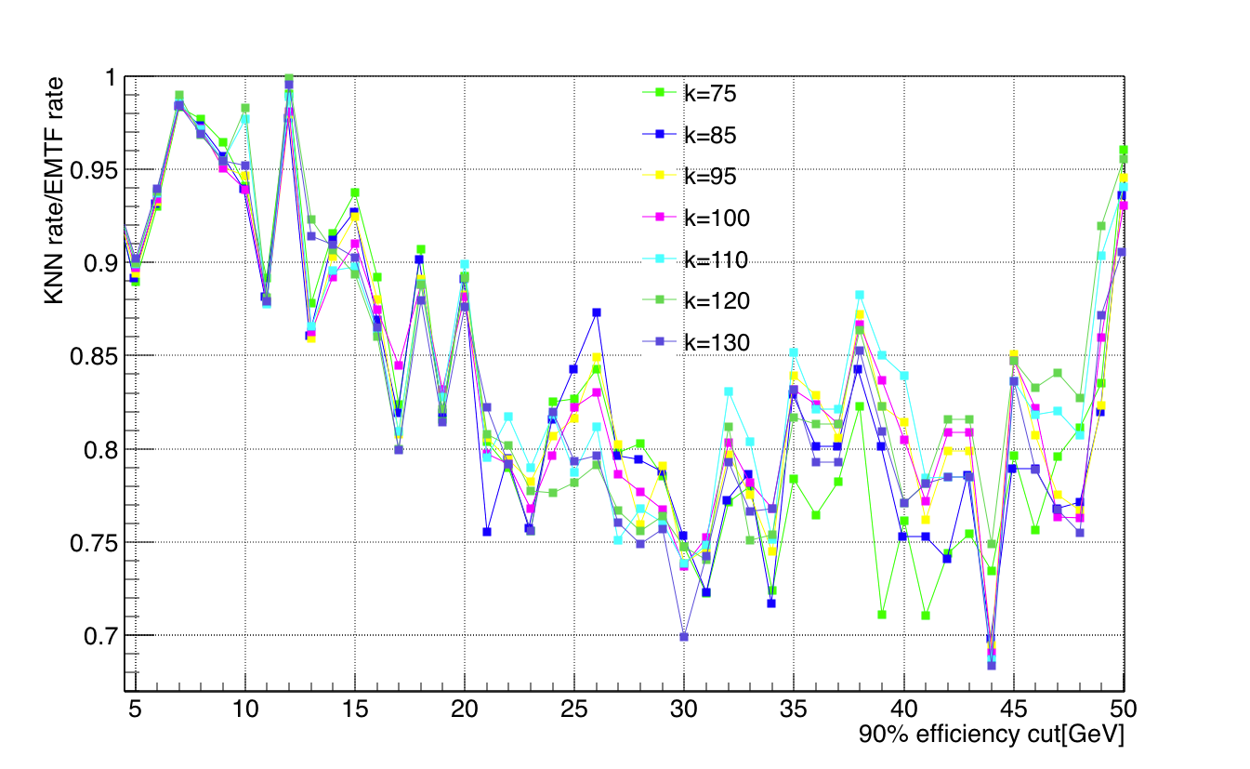
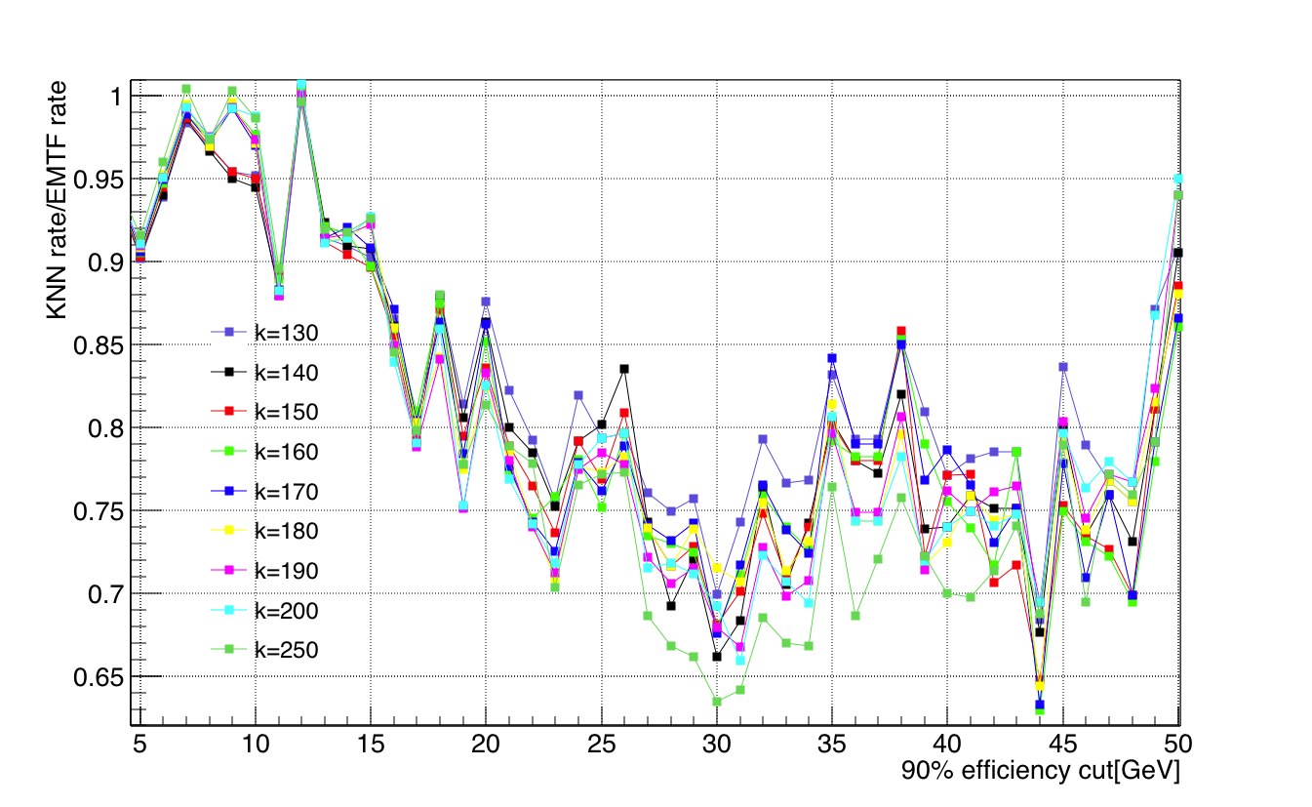
k values between 75 and 200
General trend: performance is better as k goes from 75 to 250
Depending on what the pT is, the best rate reduction comes from different k
No significant or overall improvement on pT range 5-50 GeV
Recommend using k~75, rate reduction 15%-29% more than EMTF at pT 20-40 GeV

Slide 8
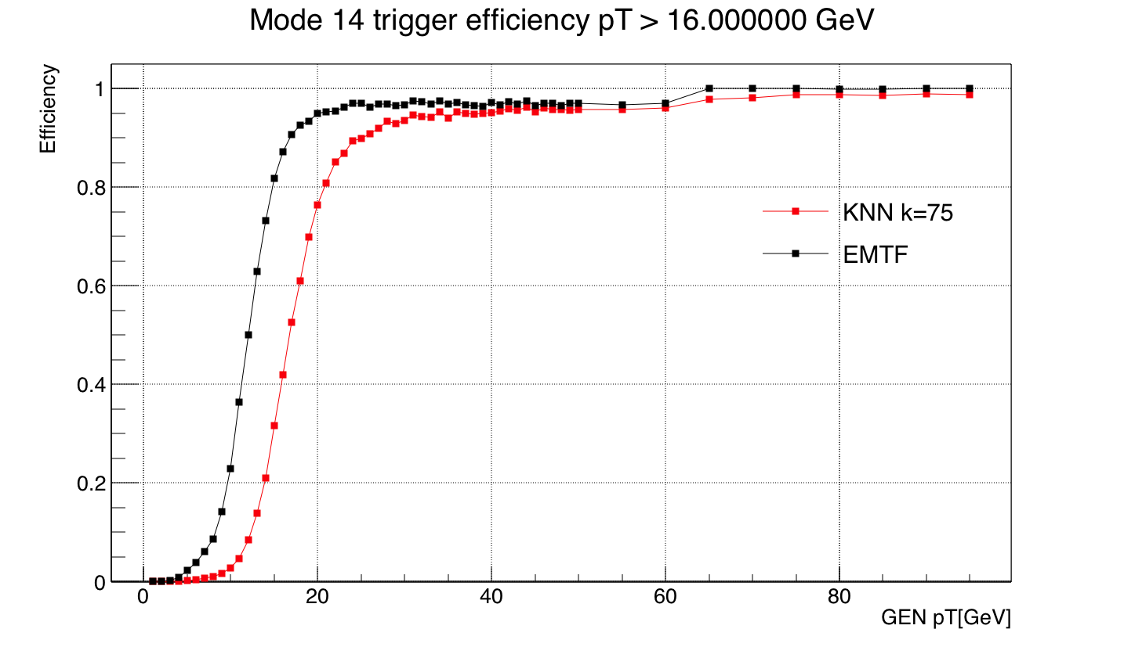
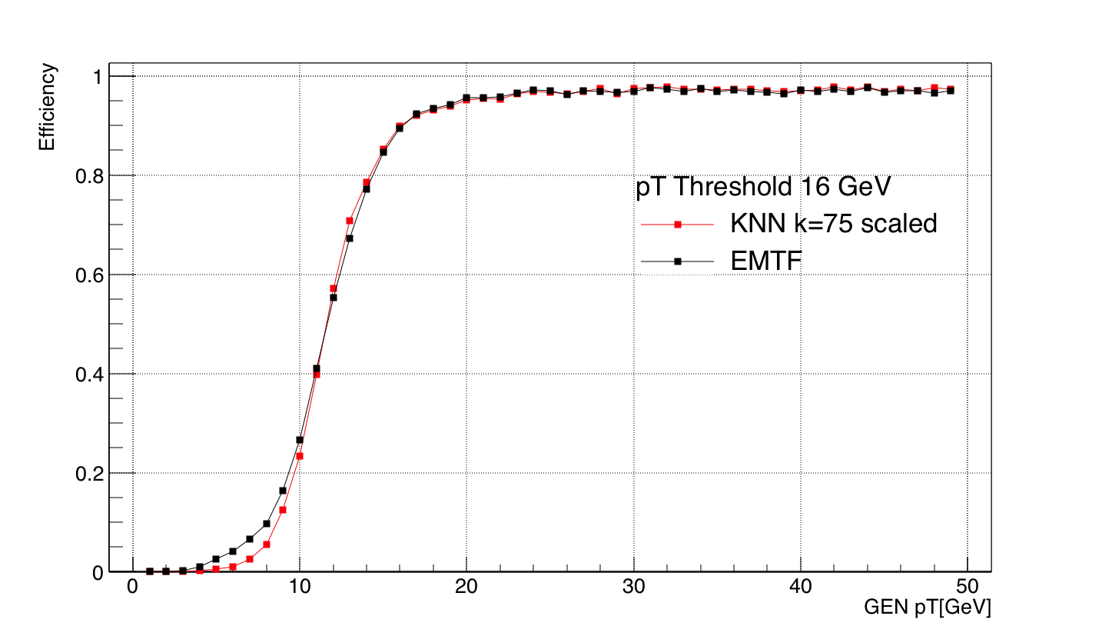
Efficiency at k=75, threshold pT 16 GeV
Projection from 2D scaled efficiency plot
Not scaled
k=75: 90% efficiency at 16 GeV, larger than 95% for pT >>16 GeV

Slide 9
Summary
KNN rate reduction starts to degrade after k~250
k~75 is recommended for a good rate reduction for pT at 5-50 GeV
k=75: 90% trigger efficiency at threshold 16 GeV, over 95% when pT >> 16 GeV

Slide 10
BACK UP

Slide 11
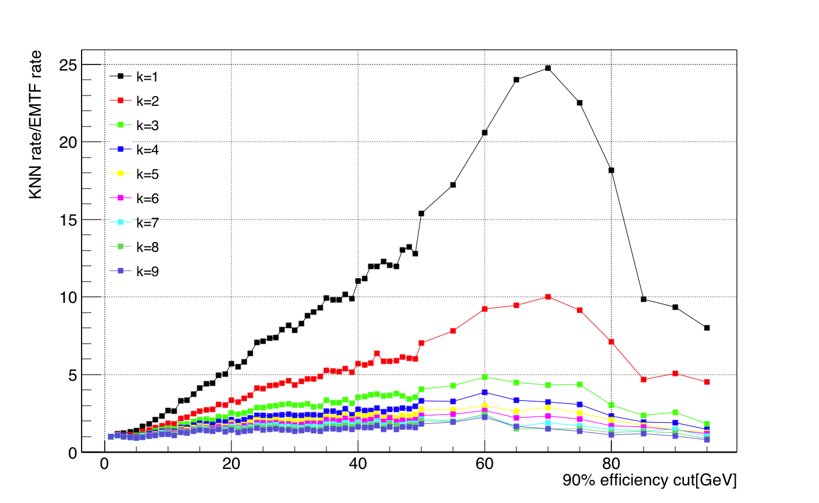
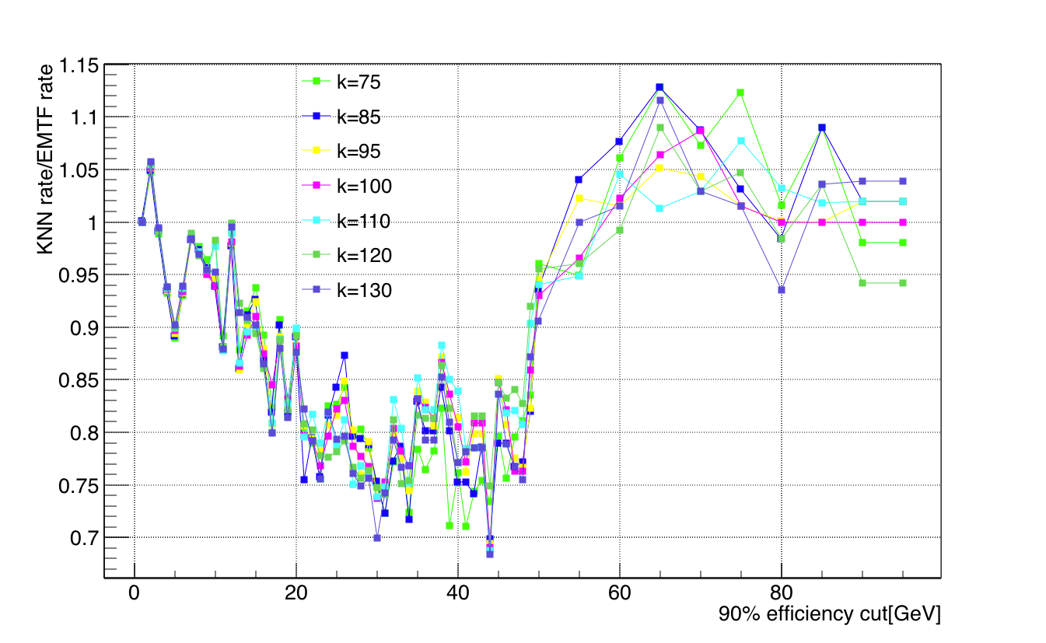
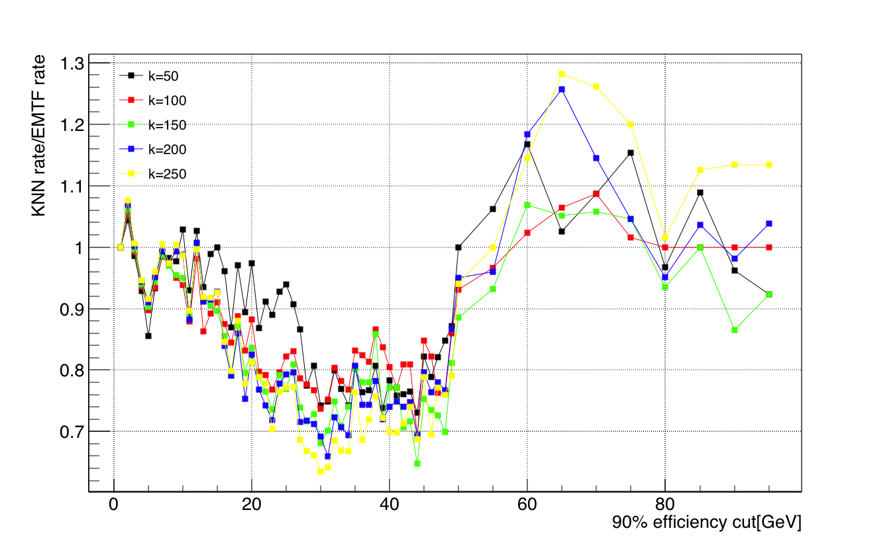
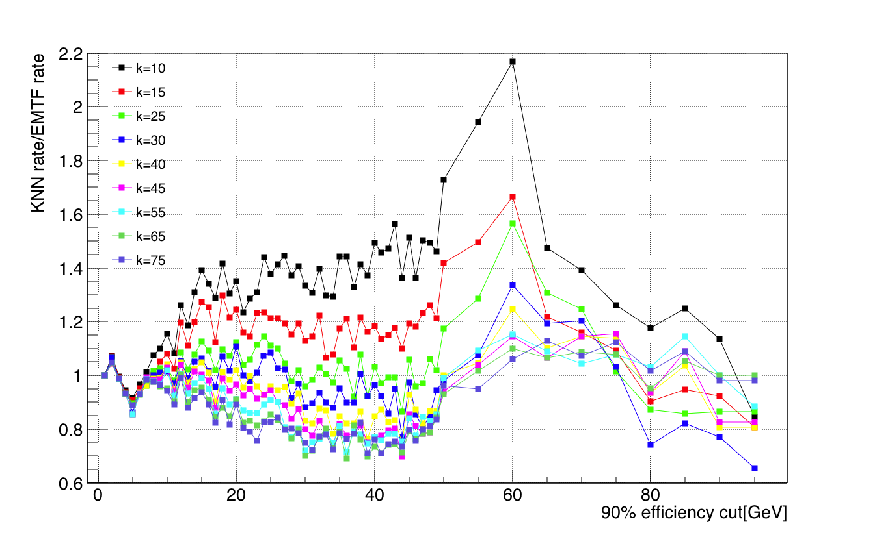
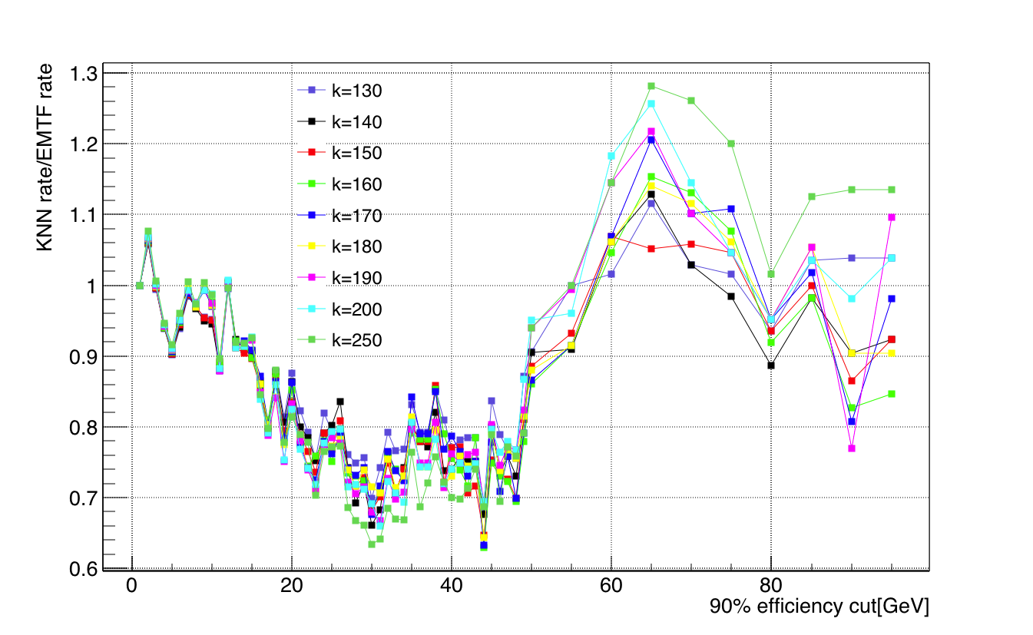
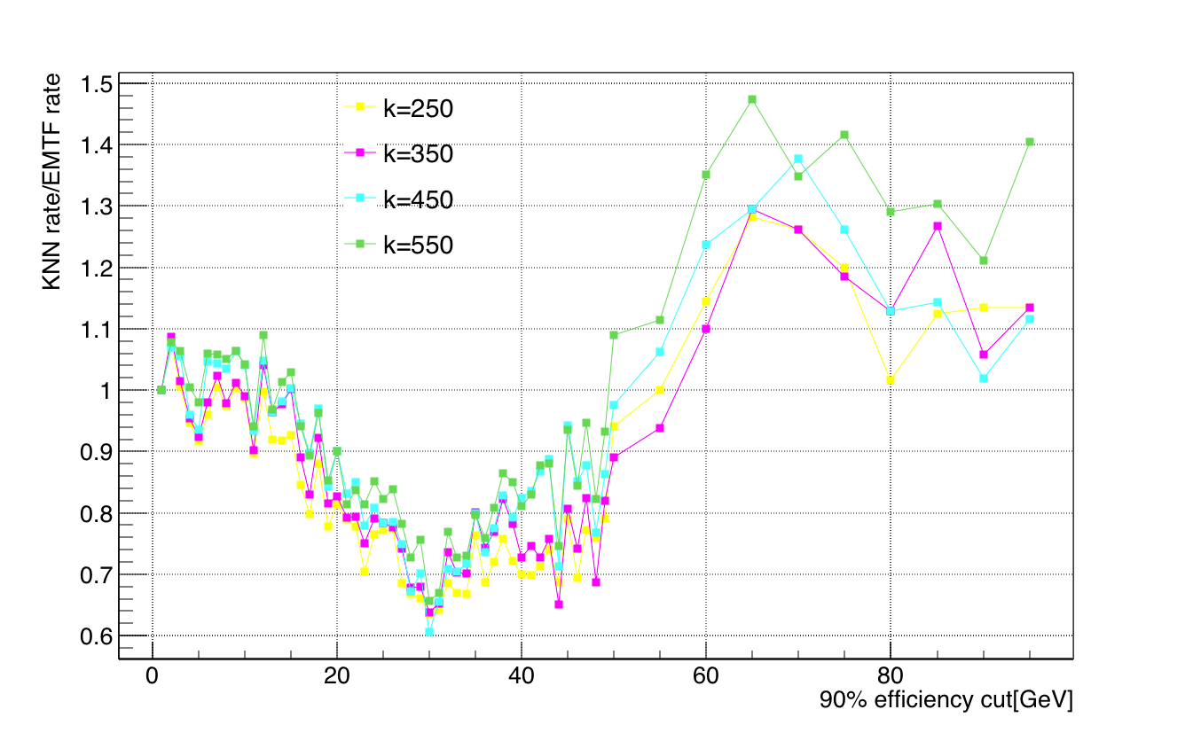
Rate tatio vs k, pT 1-99GeV

Slide 12
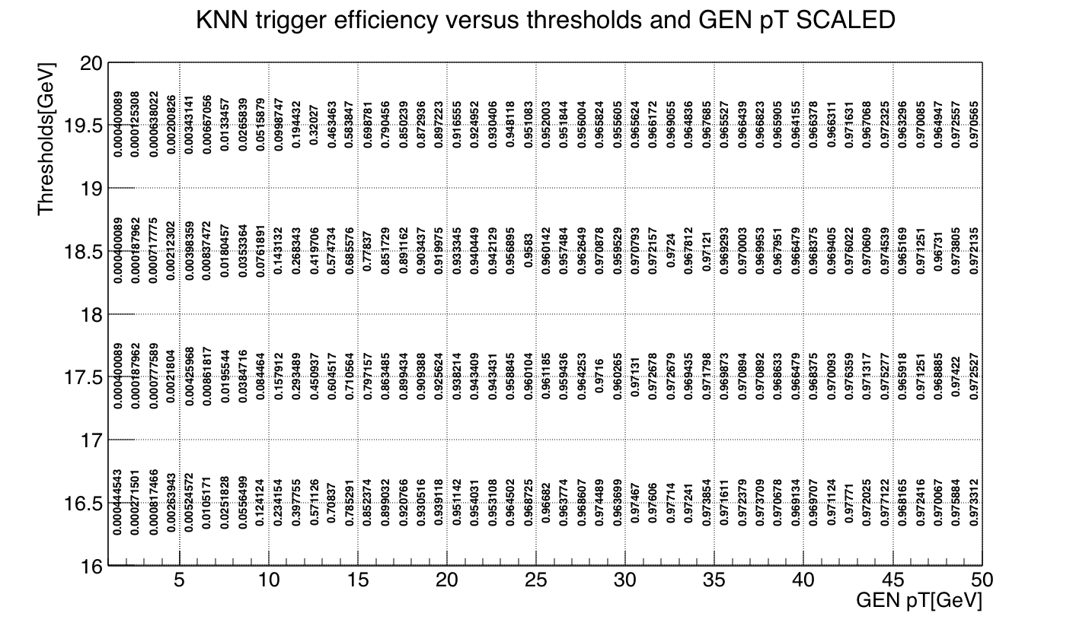
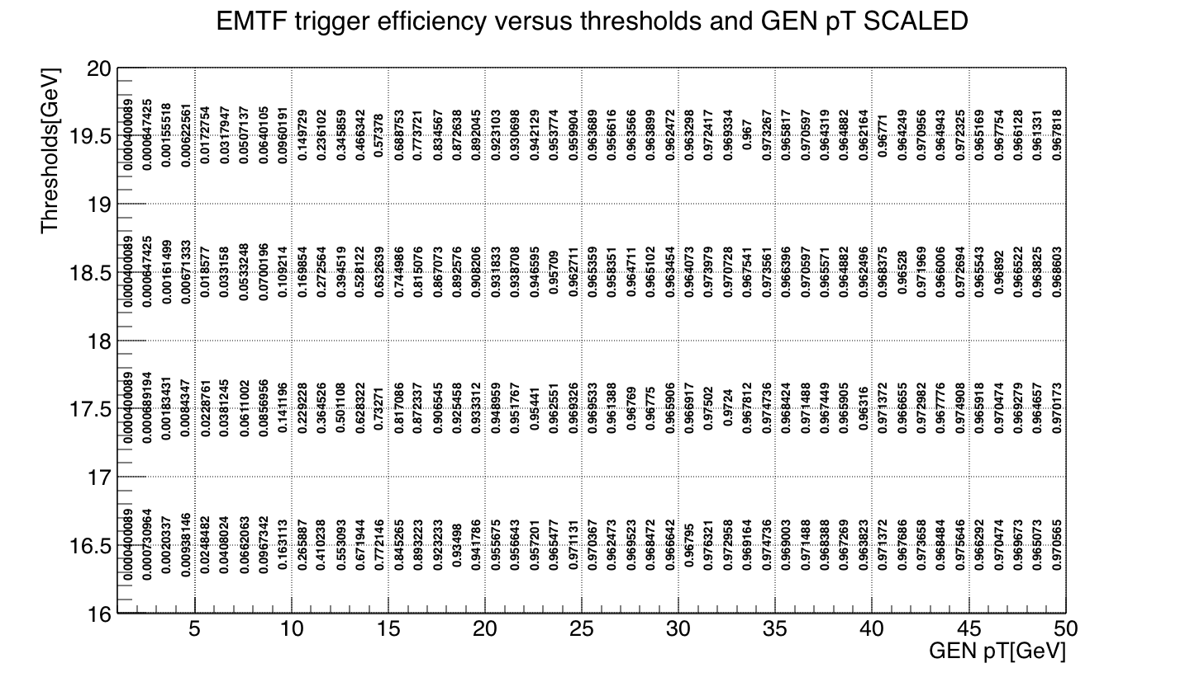
Efficiency at k=75, threshold pT 16-20 GeV

Slide 13
2016 EMTF scaled to 85% using a universal constant for all modes
All possibilities of input variables are looped(this is done offline) and put into xml file to get a LUT(~2GB), and LUT is put into firmware, online assignment only use LUT, don’t do calculation online
K-NN might affect emulator in CMSSW, which use xml instead of LUT
Include RPC, truncate bits →changes
Compare different trigger algorithms(BDT, MLP, ANN) with k-NN using the 2017 LUT variables scheme for same mode 14(add FR2, ring # in station 1, # can be 1 or 2)
Study all 3-station modes(mode 11 in EMTF may have bug)
GEN→EMTF Emulator in CMSSW(pT resolution~25%)→RECO(pT resolution 1%, can be either MC or real data)~GEN
Packing/unpacking: full precision dphi(10 bits needed for every single dphi)→nonlinear dphi, small dphi mapping is one to one, larger dphi start to reduce precisions/low resolution

Slide 14
Mode 14: Station 1-2-3
Compare to last time:
Much higher statistics(10M events, mode 14 has 787858 train and 788544 test), 42 * last time: 18746 train)
2016 LUT(dPhi12, 23; theta; CLCT1; dTheta13; FR 1)(mainly tune value k)
Low/high pT divide up
Weight 1/pT(unweight not plotted yet)
Tune KNN scale frac
Doing classification instead of regression?

Slide 15
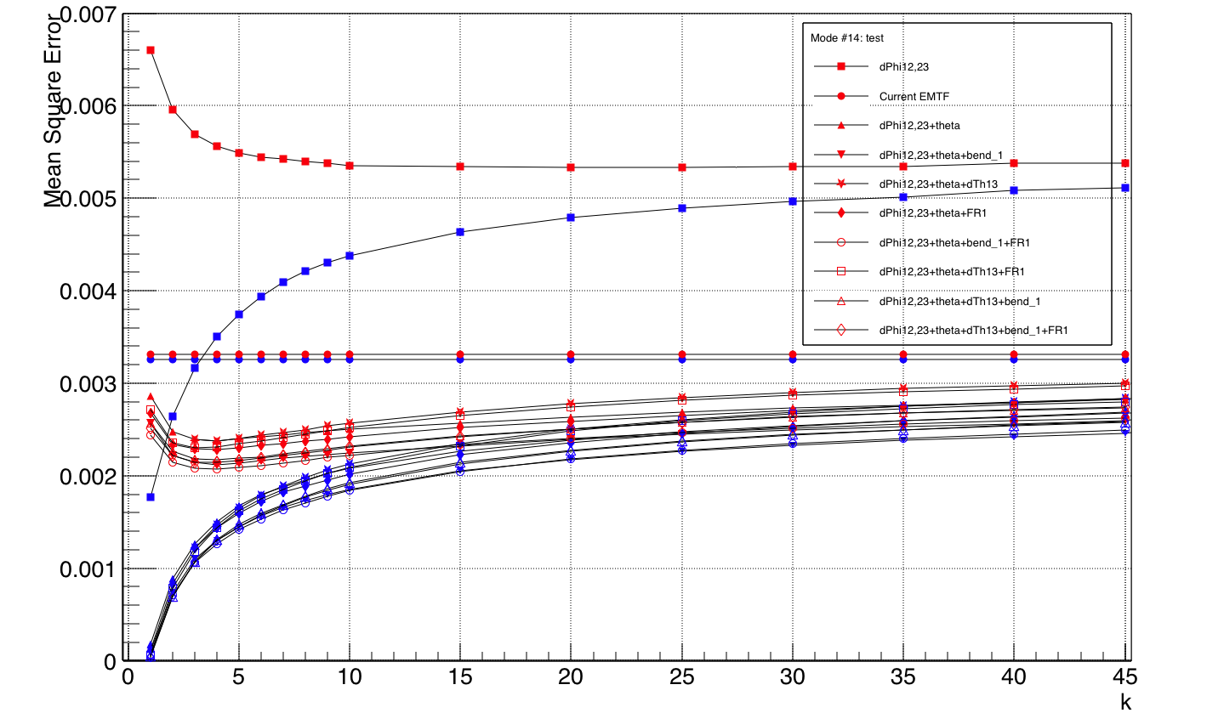
Whole pT range, weighted 1/pT

Slide 16
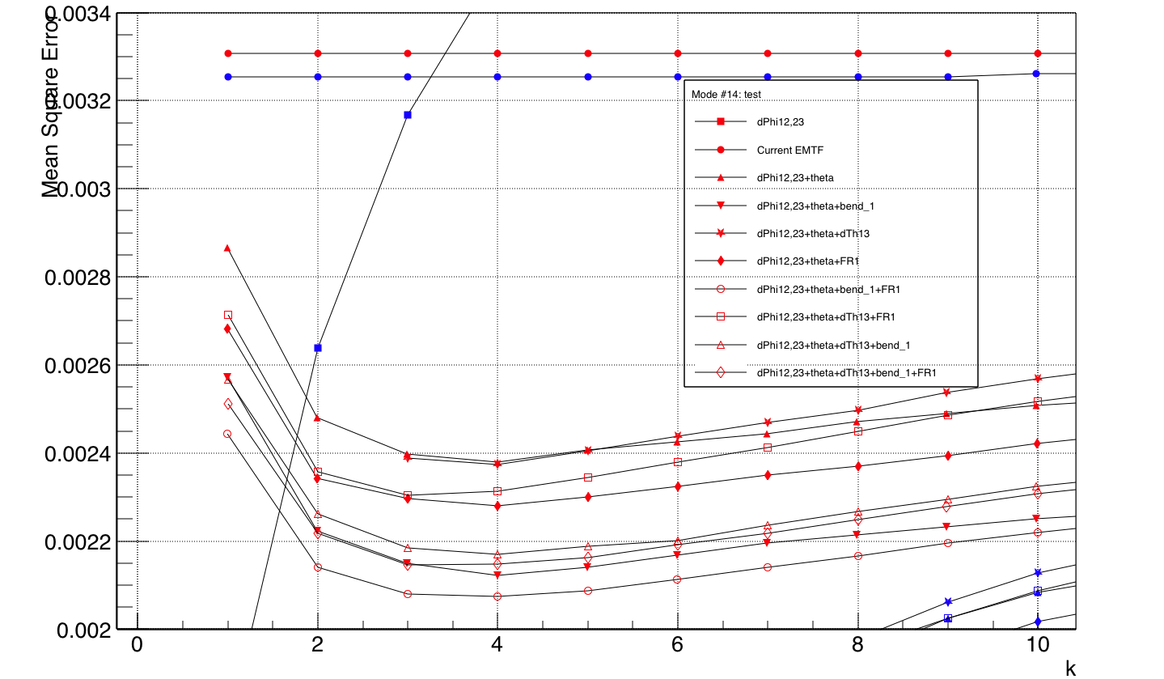
Zoom in
Add Theta significant drop of MSE
dPhis+theta+bend_1+FR1 give best performance

Slide 17
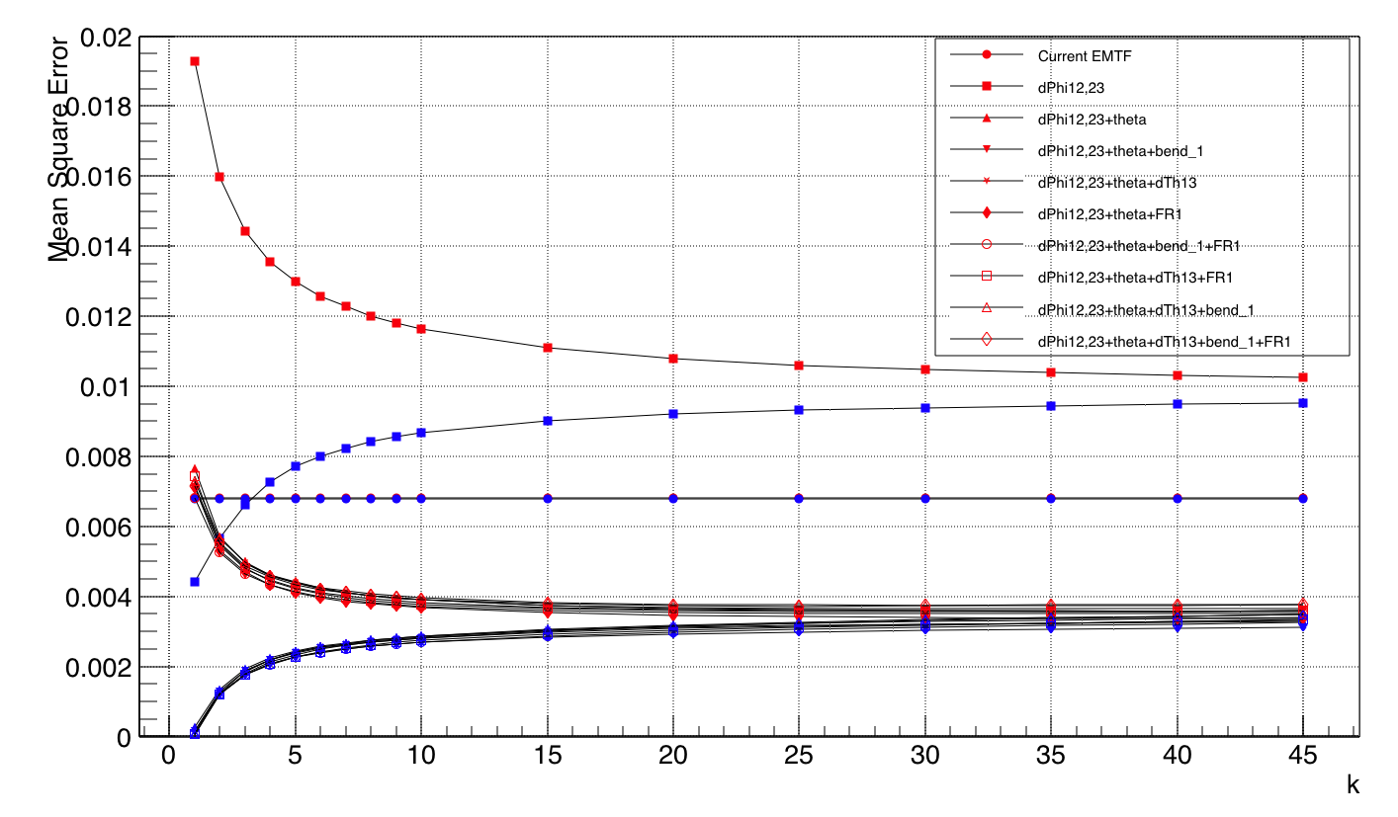
pT 1-8GeV
Over fit starts when k<10, main contribution to overtrain in whole pT range plot
Large k performance unchanged, still not enough statistics?

Slide 18
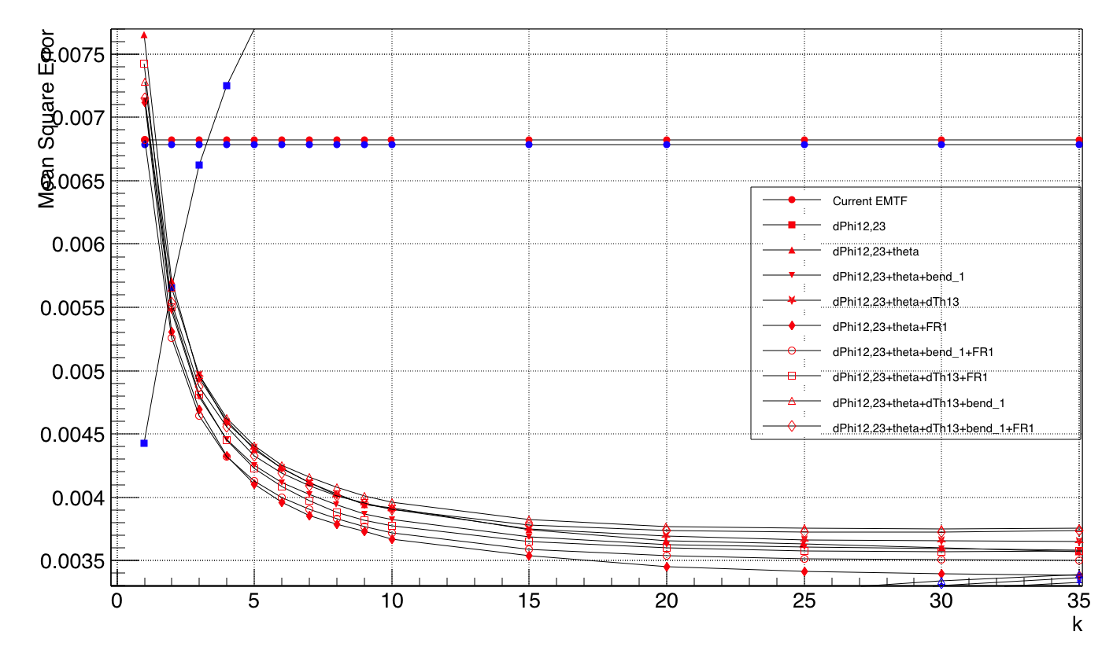
1-8GeV zoom in

Slide 19
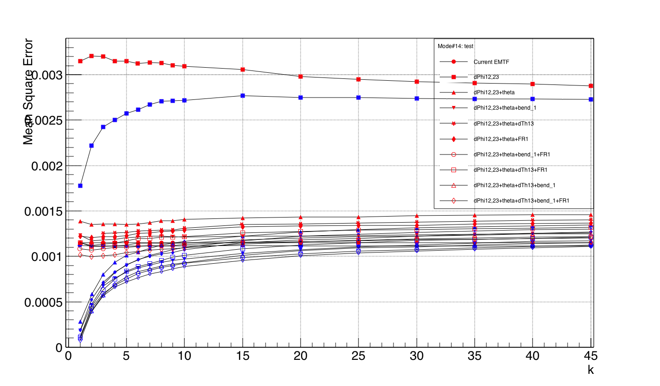
8-30GeV
Minima at k~2

Slide 20
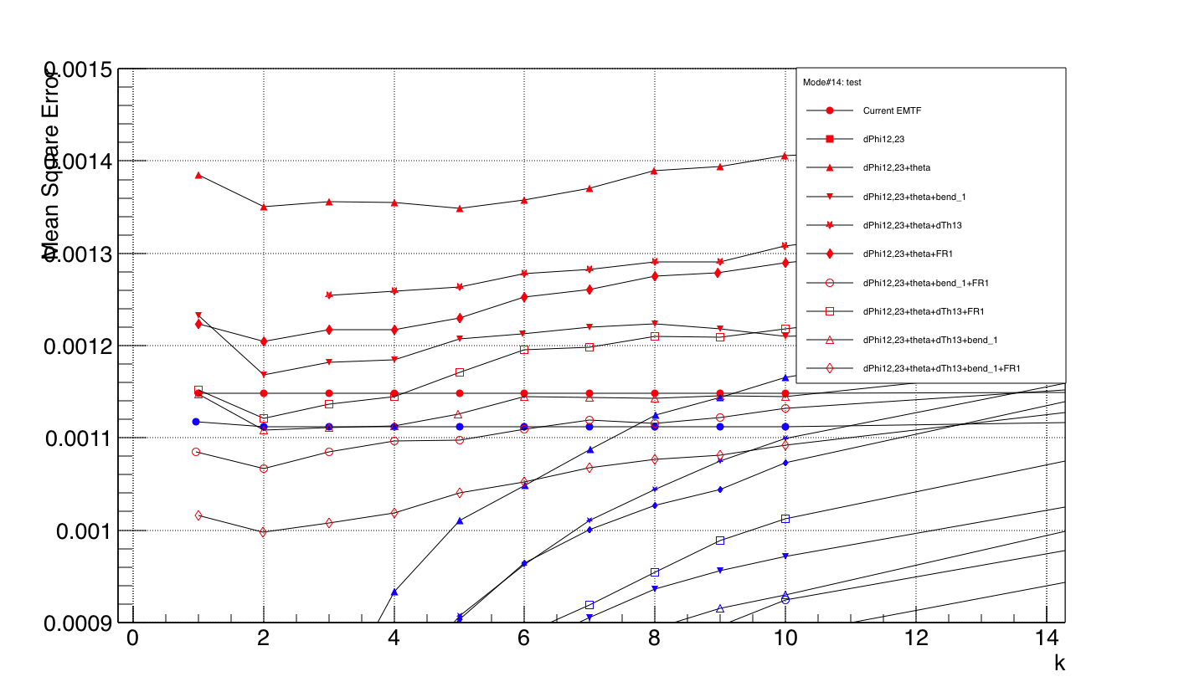
8-30GeV zoom in

Slide 21
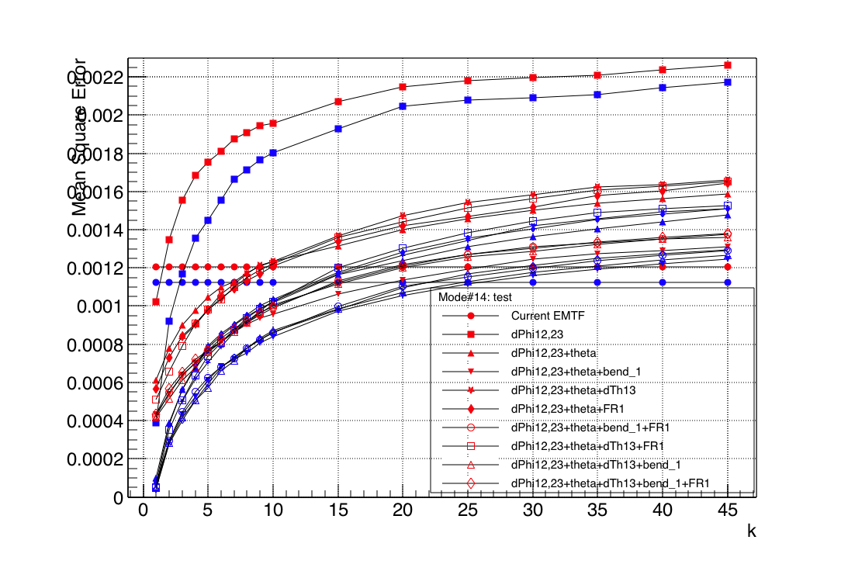
30-120GeV
MSE keeps decreasing even when k=1, too sparse input variable space?

Slide 22
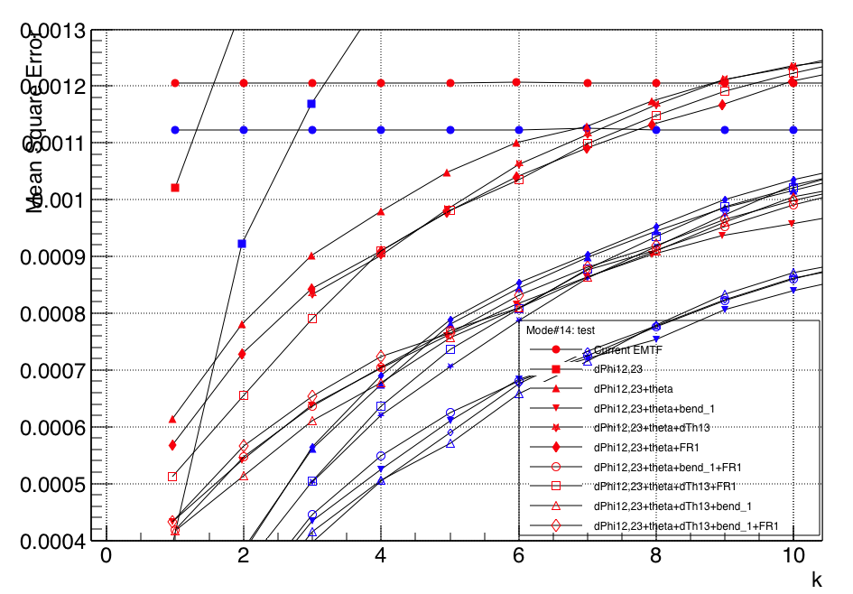
30-120GeV zoom in

Slide 23
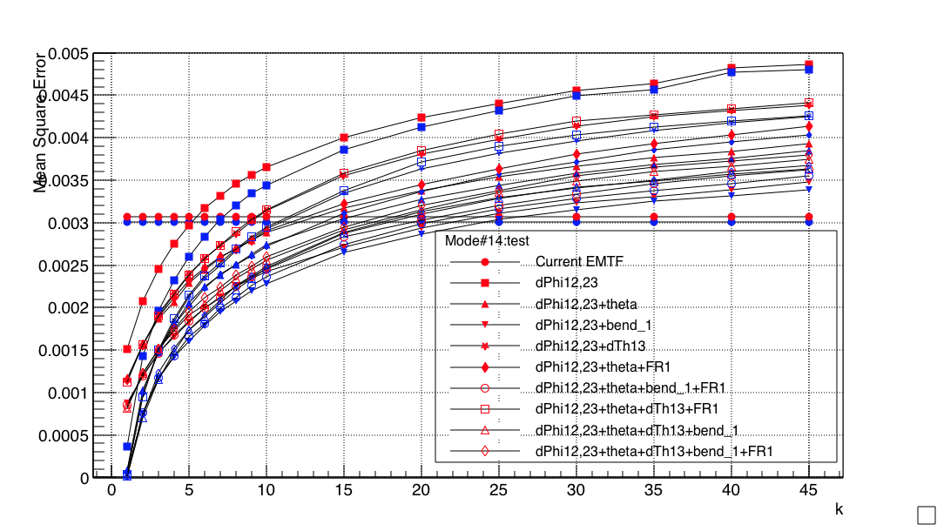
120-1000GeV
Similar to 8-30 GeV, high pT

Slide 24
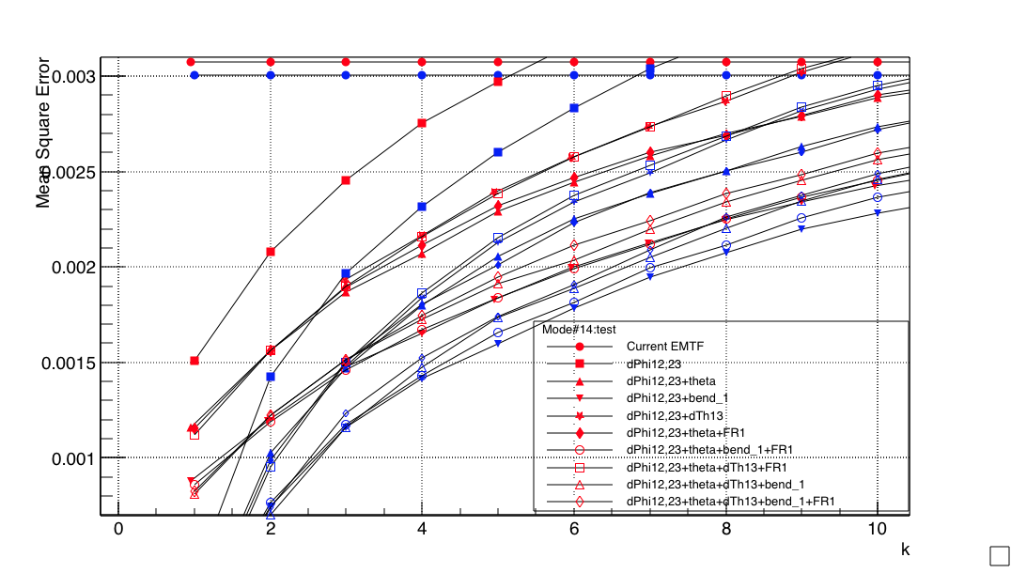
120-1000GeV

Slide 25
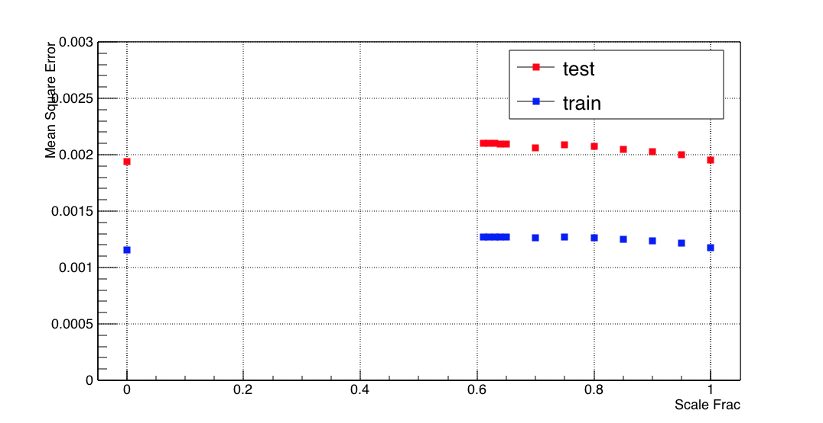
Scale the variables
Input variables have different distribution
e.g. theta has larger distribution than dphis
Need to standardize variables when calculating distance
Scale Frac = 0 means turning off scale
Scale Frac = 1 gives best performance but no big difference

Slide 26
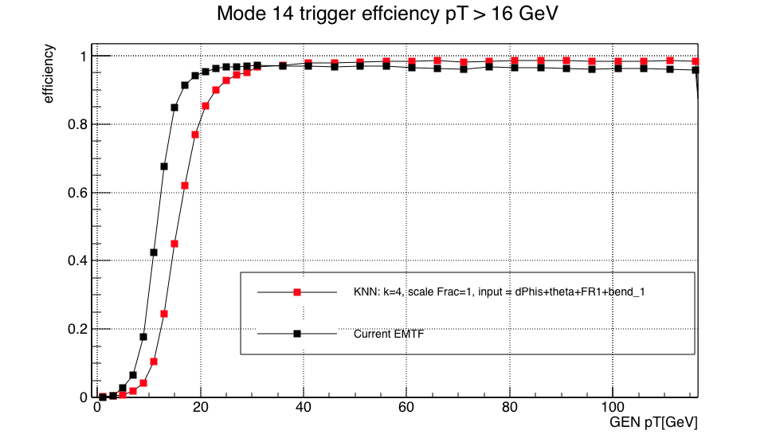
Efficiency on test sample(Not on zerobias!)

Slide 27
Conclusions
Significant drop when adding theta
Almost for all sets of input variables, k=4, Scale Frac=1, gives best performace
dPhi(12,23),theta,bend_1,FR1 are best input variables
Overfit at small k contributed from low pT 1-30GeV
high momentum seems need more data(weight 1/pT)
Flat curve at large k indicates statistics still not high enough(?)
Non-parametric method/depend on local data structure/no mapping
Large dataset/cross validation dataset

Slide 28
Steps
Find optimized input/target/k/scalfrac for KNN for other modes
Select the better method used for other modes: change inputs
Include RPC hits and repeat 1-3 step
Remove/truncate to fit in 29 bits
Repeat for other modes
Train charge assignment(classification)

Slide 29
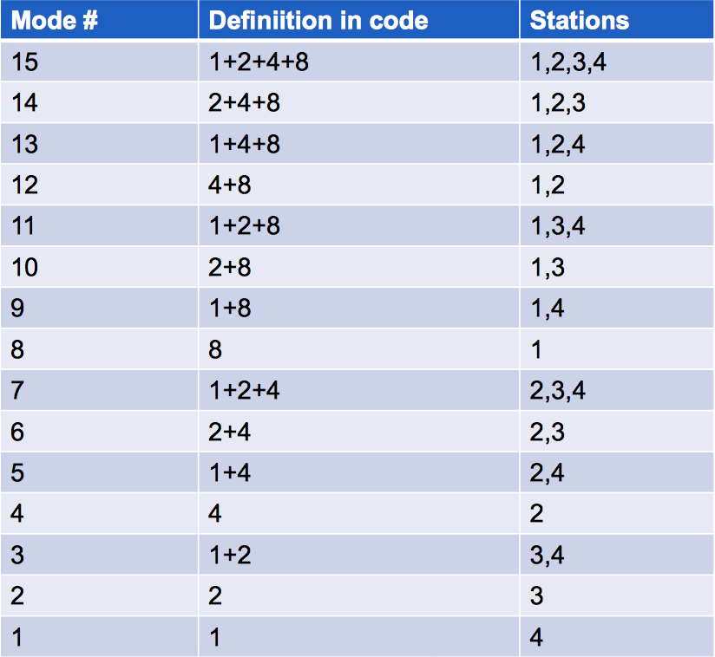
Modes

Slide 30
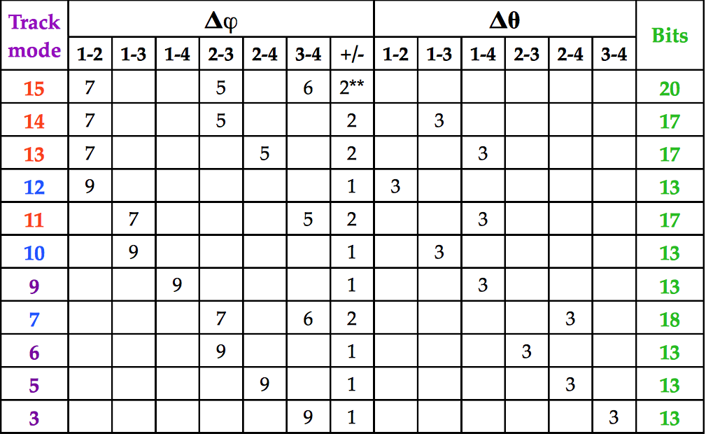

Slide 31
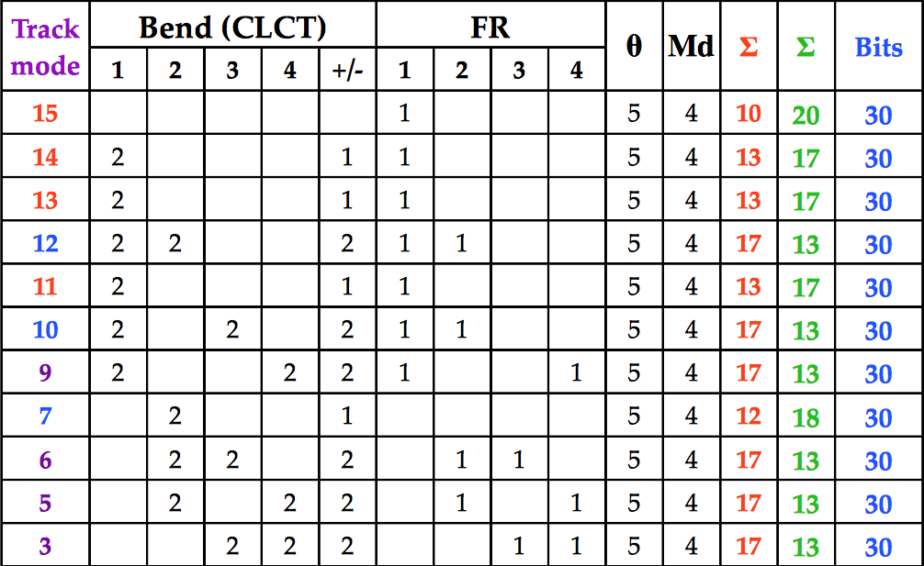

Slide 32
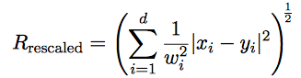
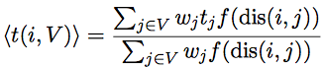
Euclidean distance
x: input variables(dimension d) of train event
y: input variables of test event
f: polynomial kernel weight function
w_{j}: weight of j in train sample

Slide 33
kNN
Tune k and Scale frac
Continuous/categorical variable: different metric(Euclidean/Hamming)
When mixture of both kinds of variables, standardization or scale variables(called feature normalization)
E.g. x’=(x-min)/(max-min); x’= (x-x_mean)/x_variance; assign weights to d(i,j)(TMVA adopts this)
A non-parametric method Unlike other supervised learning algorithms, K-Nearest Neighbors doesn’t learn an explicit mapping f from the training data
Simply uses the training data at the test time to make predictions
Need large dataset/cross validation dataset
use kd-tree to store train data, O(log(n)) time/ one search

Slide 34
KNN Regression
For a test event, the algorithm finds the k-nearest neighbours using the input variables, where each training event contains a regression value. The predicted regression value for the test event is the weighted average of the regression values of the k-nearest neighbours
The choice of the metric governs the performance of the nearest neighbour algorithm. When input variables have different units a variable that has a wider distribution contributes with a greater weight to the Euclidean metric. This feature is compensated by rescaling the variables using a scaling fraction determined by the option ScaleFrac.

Slide 35
Comments
Maybe we don’t need to choose the best model, instead, we can use weighted models for final pT LUT
Maybe we can use different model for different input variables, some model may perform better than others in certain parameter region(eta)

Slide 36
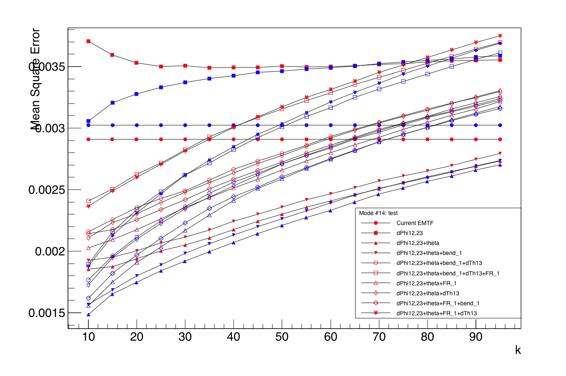

Slide 37
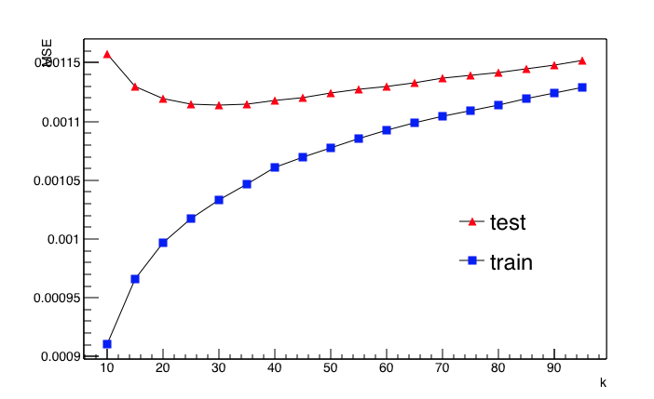
"nkNN=30:ScaleFrac=0.8:SigmaFact=1.0:Kernel=Gaus:UseKernel=F:UseWeight=T:!Trim"
Mode: 15
Input variables: dphi12, dphi23, dphi34
Target variable: 1/Gen pT
MSE = Deviation^2/N
/afs/cern.ch/work/a/abrinke1/public/EMTF/Analyzer/ntuples/EMTF_MC_NTuple_SingleMu_noRPC_300k.root

Slide 38
BDT parameters(mode 15) from Andrew B.(check)
For mode 15
400 trees
Depths: 5
1/pT weight(0-120 GeV), Log2(pT) is better target than 1/pT
For very high pT, unweighted events better(>120 GeV)
Input variables: FR bits bring significant improvement at low and high pT
In addition to track theta, FR 1, and dPhi 1-2, 2-3, and 3-4(LUT v1), add combinations of dPhis, and ring number of station 1
https://indico.cern.ch/event/608207/contributions/2451751/subcontributions/218758/attachments/1402616/2142649/2017_01_26_Mode_15_BDT.pdf

Slide 39
BDT
Good: little tuning required(simple), robust
Drawbacks:
will ignore non-discriminating variables as for each node splitting only the best discriminating variable is used
theoretically best performance on a given problem is generally inferior to other techniques like neural networks.
See TMVA tutorial

